Slide 1
Programming assignment Report
Syed Muazuddin

Slide 2
Task 1: object detection
SUMMARY :
We have to detect various elements that are present in the memes.
To catalog various elements that are detected.
Pretrained model yolo v8 has been used.
Yolo v8 has not been trained on our custom dataset, pre-trained weights have been used to detect the objects.
Yolo v8 contained 80 classes of various categories like food, transport, etc.

Slide 3
METHODOLOGIES:
The easiest method is to use pre-trained models and do object detection for the pre-defined classes.
The dataset contained more elements like Muslims, specific animals, Asians, black people. A custom built model for these majority classes would have been much better than a pre-trained model.
As the dataset was huge, I used the distribution of the objects to create a sample dataset which could be used for the other tasks.

Slide 4
ISSUES FACED:
Lack of compute power because of which object detection took lot of time.
The pre-defined classes were not enough to capture the total distribution of the dataset.
The dataset was not annotated due to which building a custom object detection model was not feasible.
The captions acted as barriers for the detection of objects thereby failing to capture more details .

Slide 5
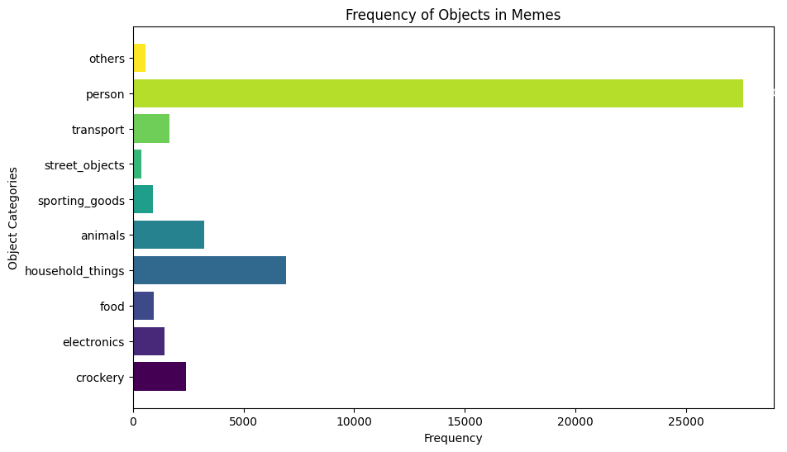
RESULTS & FINDINGS :
As expected the most frequent element in the memes was 'humans'.
If frequency of person is kept aside, household things and animals have taken the next ranks.
Many of the memes contained Muslims, Americans, Hitler, Asians, Black people, goats, etc.

Slide 6
IMPROVEMENTS:
If object detection was performed after removing the captions, the result would have been better.
If a group/team is available, they can annotate the dataset to build a custom object detection model which will be far accurate in detecting the elements.

Slide 7
Task 2: Caption impact assessment
SUMMARY :
Assess the impact of caption on object detection.
Use image processing techniques to remove the caption from the images.
Reconstruction of images after the caption is removed.
Comparison of confidence levels of both the original and processed images

Slide 8
METHODOLOGIES:
To assess the impact of the captions on the object detection, the captions have been removed using functions from the module keras_ocr.
The confidence levels of predictions in the processed and original memes have been compared to analyze the impact.
The change in object detections, before and after the processing have been also compared to understand the impact of captions better.

Slide 9
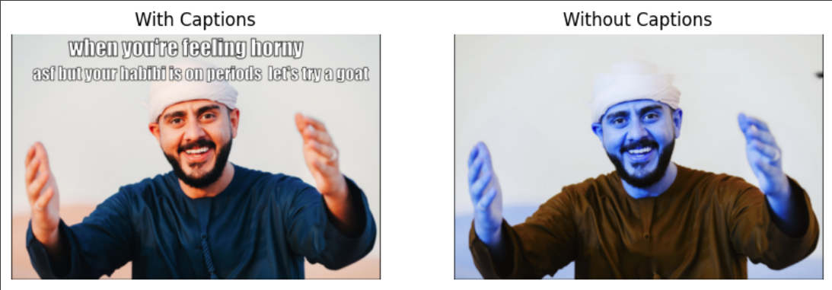
ISSUES FACED:
The quality of the image reconstruction after the captions have been removed was not good as expected.
Due to which the object detections after the processing was also affected.
The confidence levels of predictions dropped in the processed images.
It was really a difficult task to remove captions from all the images since the dataset was huge I was able to remove captions from only 215 images, the cell continued running but the new caption removed images didn’t save for some unknown reason

Slide 10
IMPROVEMENTS:
A better image processing technique to remove the captions will help us understand the caption impact better.
Detections around the captions could be avoided to reduce wrong detections.
T4 GPU or any other GPU is highly preferred since this saves a lot of time.

Slide 11
RESULT:
The negative confidence levels increased compared to the positive confidence level in the object detections after processing.
The number of objects detected in many processed images has gone down compared to their original images, this is an indication that there have been many misclassifications due to the captions.
No images had new detections which had 0 objects in them even after processing.

Slide 12
Task 3: classification system development
SUMMARY :
Develop a classification system based on something non-trivial.
I chose to develop a classification system which could predict whether a given image is meme or not.
Data for the positive set class was provided, collected for the other class from Kaggle dataset of Meme Classification.

Slide 13
METHODOLOGIES:
There are two ways in which we can build this model:
Build a simple CNN classifier fed with the memes and non-memes directly.
The other approach is to extract features the caption and the images separately and combine them to form a single vector which would capture more meaning.
But every non-meme image may not contain captions.
In my code I built a simple CNN classifier using keras library, since the dataset contained only a total of 1400 images it was quiet easy to split the data and train and test the model

Slide 14
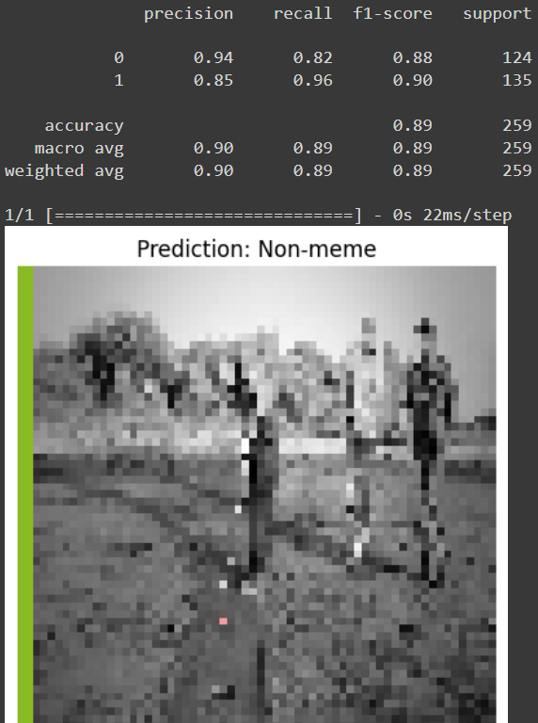
ISSUES FACED:
Some of the details from the image were lost in order to predict whether it’s a meme or not
Due to less training data the model was more likely to overfit the data
RESULTS :
The Accuracy was found to be very good ~ 0.9
The Model was able to provide correct prediction yet was unable to preserve much details of the image

Slide 15
References:
https://www.freecodecamp.org/news/how-to-detect-objects-in-images-using-yolov8/
https://valueml.com/meme-classification-using-cnn-in-python
https://github.com/bnsreenu/python_for_microscopists
https://www.kaggle.com/datasets/vineethakkinapalli/memes-classification-dataset/code

Slide 16
Thank you

